Slide 1

Unveiling the Unseen: The Rao, Hartley, and Cochran Random Method
Notes:
1

Slide 2
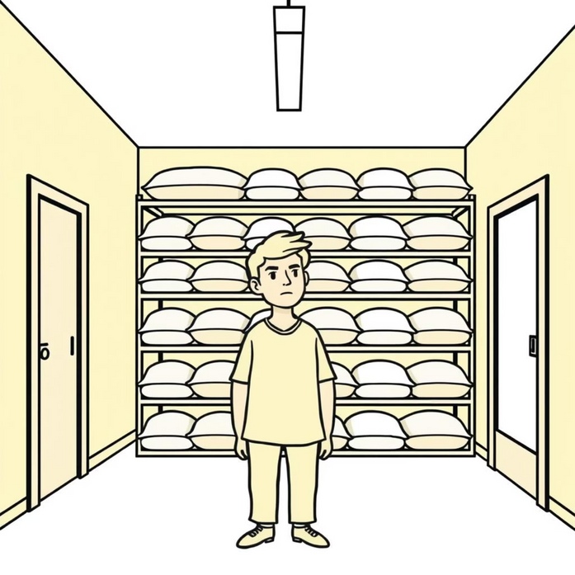

Counting Rice During Covid Quarantine
An RHC Method Adventure in Home Sampling
Notes:
2

Slide 3



The Architects of Chance
C.R. Rao
W.G. Cochran
A giant in theoretical statistics known for significant contributions to multivariate analysis and estimation theory.
Authored influential texts on experimental design and sampling techniques, focusing on practical applicability in research.
1
2
3
H.O. Hartley
Pioneered techniques in sampling theory and statistical computing, particularly variance estimation methods.
Notes:
3

Slide 4



Enter the Rao-Hartley-Cochran Method
RHC Sampling: The smart, rigorous way to divide the population to select a proportional sample.
Divide
Select
Estimate
Split the population into smaller, random groups (sub-samples).
Choose exactly one unit from each random group.
Use the selected units to form an unbiased overall estimate.
Notes:
4

Slide 5
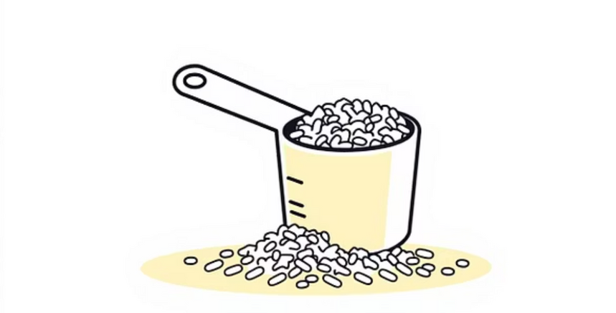
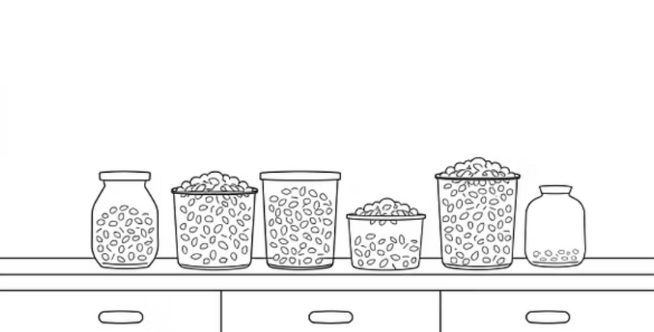

Setting Up the Rice Experiment
Define Population
Create Subsamples
All rice grains in the pantry (approx. 5 kg).
Randomly draw small, weighted subsamples from each bag.
Establish Frame
Measure & Count
Divide total rice into manageable, equal-sized bags.
Precisely count grains in the selected subsamples.
Notes:
5

Slide 6
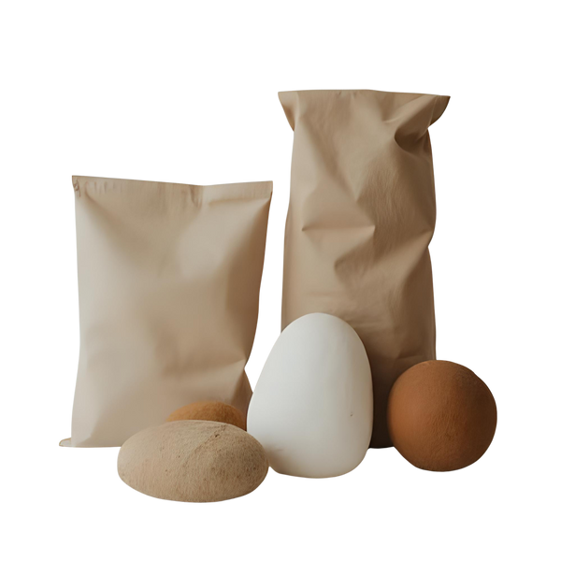

How RHC Works
Group 1
1225g Rice
Fair Sample (N=4)
5kg rice grains
Group 2
1225g Rice
One from each group
Group 4
Group 3
1225g Rice
1225g Rice
Notes:
7

Slide 7
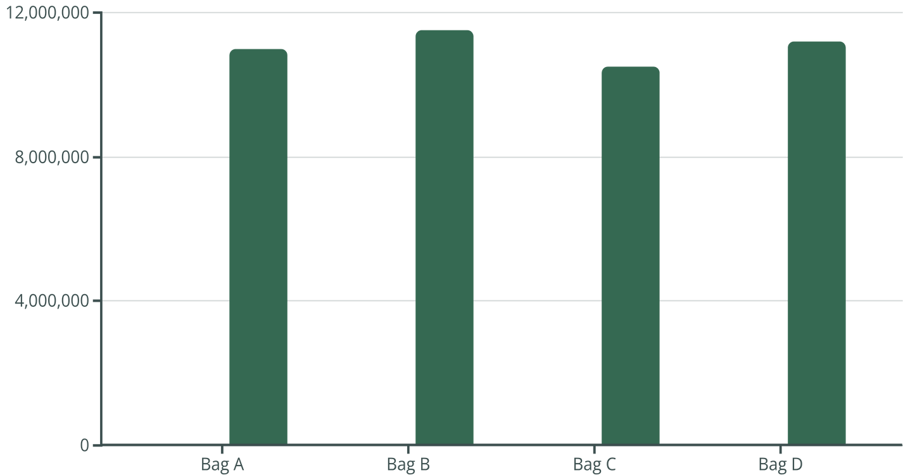
Visualizing the Data
Estimating the Grand Total
Sample Count (Grains/g)
Total Estimated Grains
Final Estimate: 44.2 Million Grains (with a 95% confidence interval of +/- 50,000 grains).
Notes:
8

Slide 8

From Chaos to Clarity: How the Method Works
The RHC method is a sophisticated approach to Probability Proportional to Size (PPS) sampling, dividing a population into non-overlapping groups before selecting samples.
Estimate
Partition
PPS Select
Notes:
9

Slide 9

Assumptions
1
2
Stratification: Dividing the population into non-overlapping groups (the bags of rice).
Proportional Allocation: Ensuring sample size reflects the size of each stratum.
3
Unbiased Estimation: Using the RHC estimator formula to calculate the total count.
"RHC offers low variance and near-perfect balance, even with simple randomization."
Notes:
6

Slide 10
Summaries the formulas
The power of the Rao, Hartley, and Cochran method lies in its elegant mathematical foundation, specifically in the variance formula, which simplifies estimation.
RHC Estimator for the Population Total (Y)
Where $y_i$ is the value of the characteristic for the unit sampled from group $i$, and $p_i$ is the probability of selecting that unit within its group.
RHC Variance Estimator
This variance expression is exact and often lower than the variance provided by standard Simple Random Sampling without replacement (SRSWOR), demonstrating RHC's superior efficiency in PPS scenarios.
Notes:
10

Slide 11
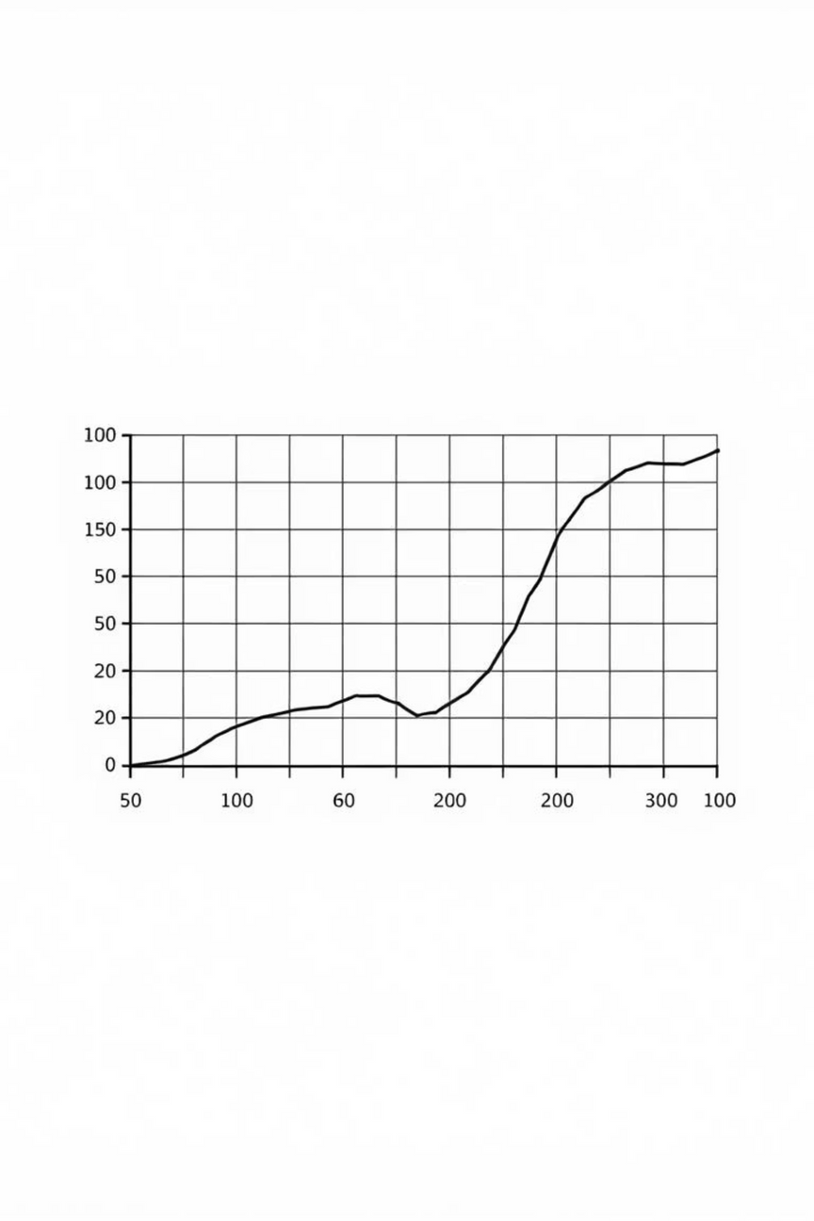



Why RHC Matters: Fairness and Precision
RHC is a powerful tool used when units in the population have different sizes or importance.
Higher Efficiency
Often provides lower variance (more precision) than other PPS methods.
Unbiased Results
The resulting estimates are always unbiased, ensuring fairness.
Simpler Calculation
Easier variance estimation, making it practical for real-world application.
Notes:
12

Slide 12



Unexpected Challenges and Learnings
Non-Uniformity
Efficiency Gains
Broken or unevenly sized grains introduced slight measurement error. RHC accounted for this variance well.
Counting four 10-gram samples took 30 minutes. Estimating the total population would have taken months.
Lesson Learned
Complex statistical methods are highly scalable and applicable to everyday, real-world estimation problems.
Notes:
11

Slide 13

Limitations
Computational Complexity
Requires complex computations for variance estimation, increasing effort and potential for error.
Subgroup Allocation Difficulty
Optimal division of population into subgroups can be challenging and non-intuitive.
High Variance Risk
Potential for increased variance if the initial population division is poorly executed.
Unequal Subgroup Sizes
Performance can degrade significantly if the defined subgroups are highly disparate in size or structure.

Slide 14




Real-World Whispers: Impact & Applications
Socio-Economic Surveys
Used in national surveys (e.g., census follow-ups) to select primary sampling units (like villages or districts) proportional to their population size, ensuring balanced representation.
Forestry & Ecology
Sampling forest plots proportional to area or tree density to estimate timber volume or biodiversity with high precision.
Industrial Quality Control
Selecting samples from batches or production lines proportional to their size to quickly assess overall product quality or defect rates.
Notes:
14

Slide 15
Comparison of Unequal Probability Sampling Methods
n=2 Methods
Durbin: High efficiency, complex
1
2
Brewer: Simple, good variance
n > 2 Methods
PPS (With Replacement): Simple, high variance
3
4
Murthy: Unbiased, complex
Raj: Sequential, efficient
5
6
Sampford: Minimum variance, complex
RHC: Group-based, robust variance
7

Slide 16
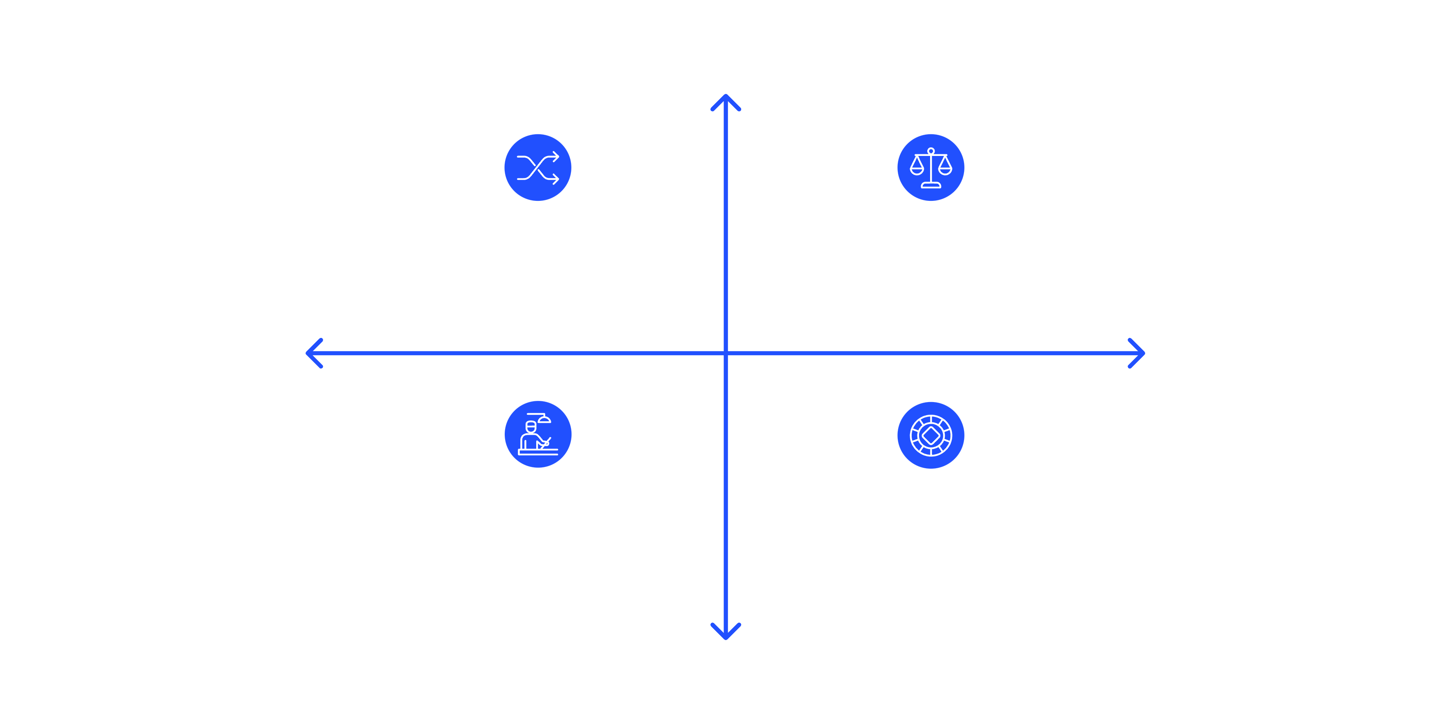
Choosing the Right Method for Your Data
RHC is a powerful technique, but it must be applied judiciously. Evaluate context, data availability, and desired precision.
High Variance Reduction
RHC — High variance reduction, moderate effort
Brewer — High reduction, higher effort
Low Effort to Implement
High Effort to Implement
Murthy — Low reduction, easy to implement
Simple Random — Low reduction, low effort
Low Variance Reduction
The best sampling design minimizes cost for a fixed level of precision or maximizes precision for a fixed budget.

